Slide 1

BERT - Experiments

Slide 2
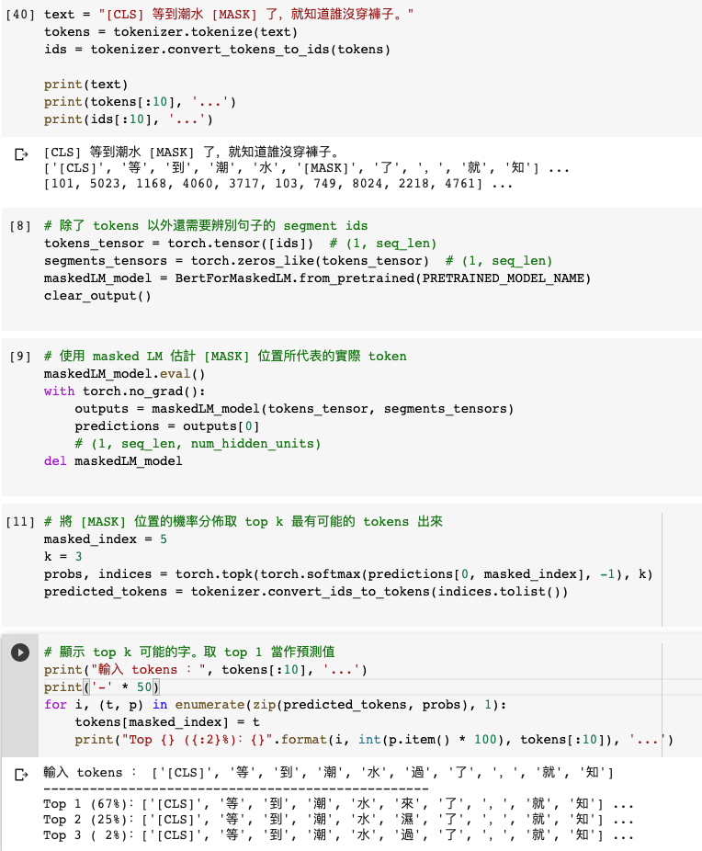
Masked Language Model (MLM)

Slide 3
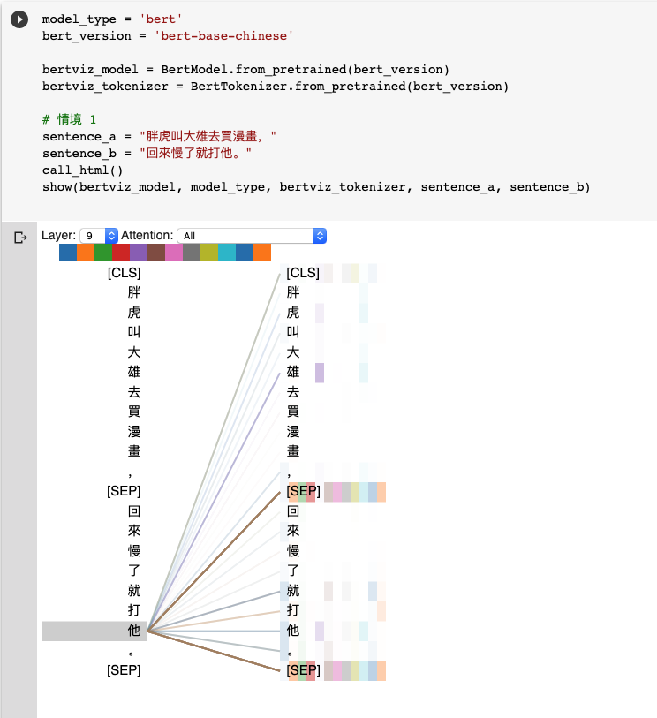
Natural Language Inference (NLI)
Attention Visualization

Slide 4
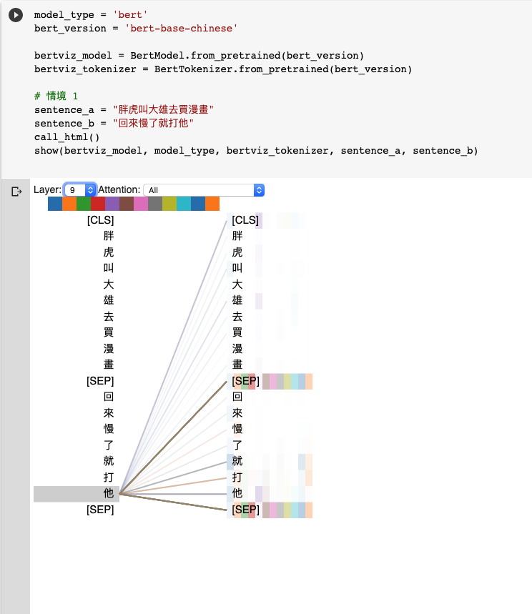
Natural Language Inference (NLI)
Attention Visualization

Slide 5
Source Code Analysis

Slide 6
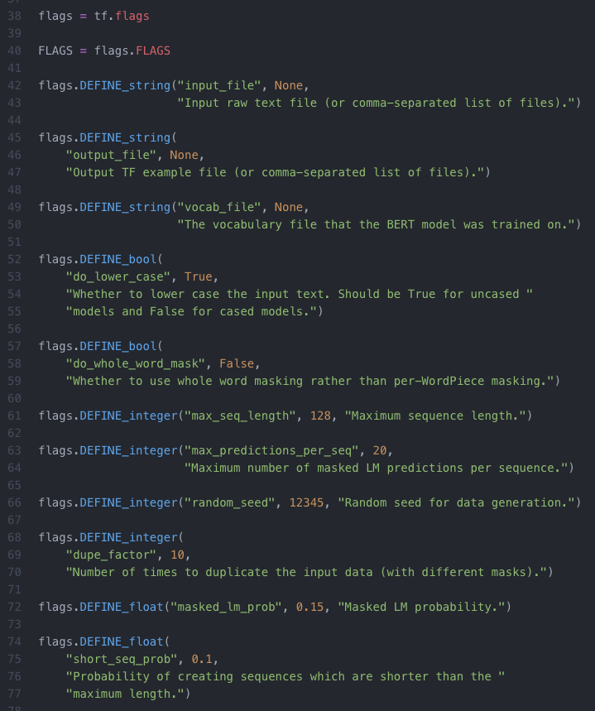
input_file
output_file
vocab_file：指定字典路徑（Google提供, Tokenization 會用到）
do_lower_case
max_seq_length：每一條訓練數據（兩句話）相加後的最大長度限制 (128)
max_predictions_per_seq：每一條訓練數據mask的最大數量
random_seed：隨機種子 (12345)
dupe_factor：對文檔多次重複隨機產生訓練集，隨機的次數 (10)
masked_lm_prob：訓練數據產生mask的概率 (0.15)
max_predictions_per_seq*masked_lm_prob數量的mask
short_seq_prob：為了縮小預訓練和微調過程的差距，從而概率產生小於max_seq_length的訓練數據

Slide 7
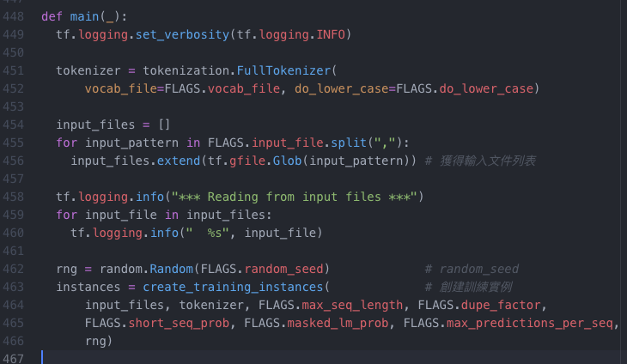
預訓練
核心模型構建
訓練
create_pretraining_data.py
modeling.py
run_pretraining.py
def create_training_instances
創建訓練實例
Devlin, Jacob, et al. "Bert: Pre-training of deep bidirectional transformers for language understanding." arXiv preprint arXiv:1810.04805 (2018).

Slide 8
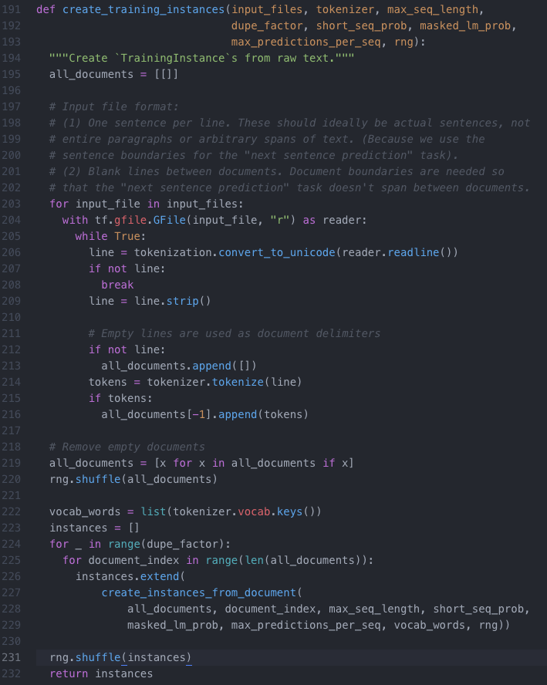
Input File Format Restriction
Pre-training
Tokenization
Tokenization

Slide 9
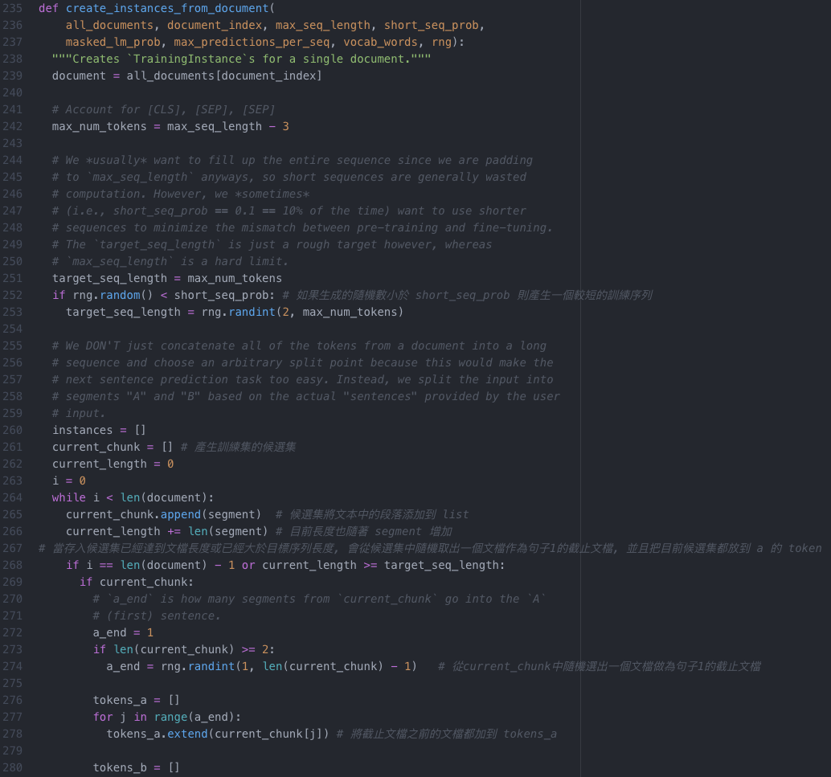
[CLS], [SEP], [SEP]
Pre-training
Next Sentence Prediction (NSP)
short_seq_prob
current_chunk
current_chunk
token
current_chunk
token

Slide 10
ELMo, BERT, GPT

Slide 11
Word Embedding
One-Hot-Encoding
Bag-of-Words (BoW)
一詞多義
1 type 1 embedding
1 type 固定數量的 embedding
每個 token 不同的embedding
Contextualized Word Embedding

Slide 12
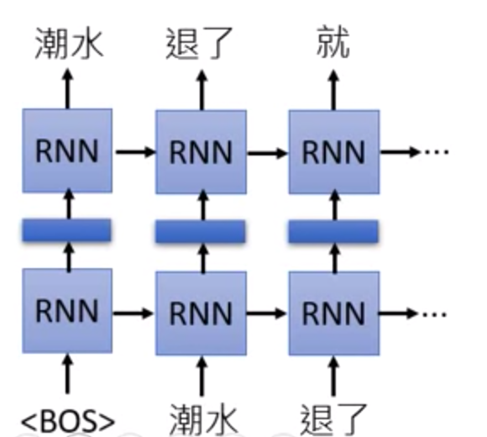
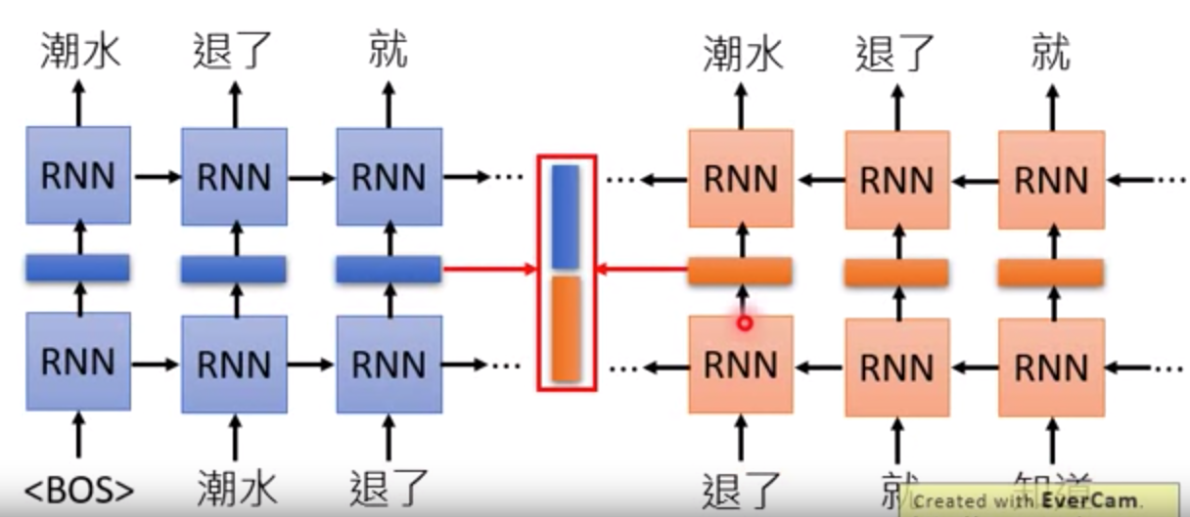
Embedding from Language Model (ELMo)
RNN-based Language Model: 蒐集未標註的句子, 再由RNN訓練
只考慮到左側上文

Slide 13
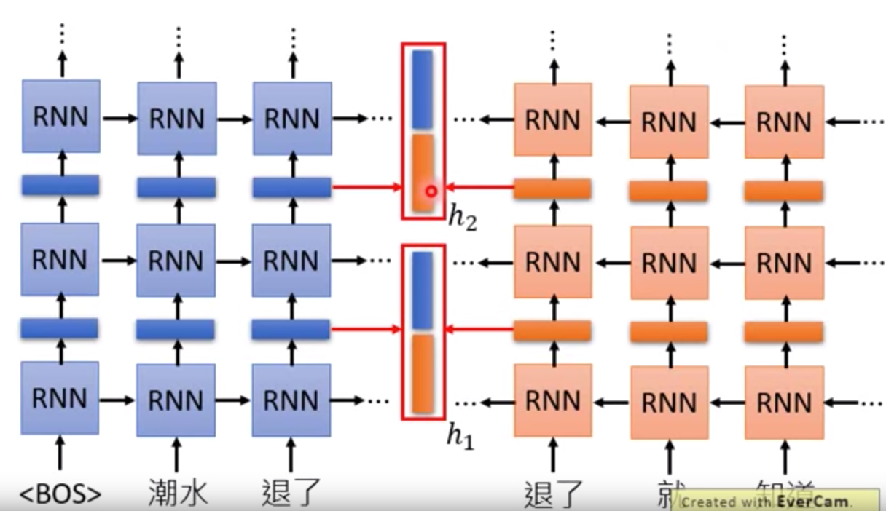
Embedding from Language Model (ELMo)

Slide 14
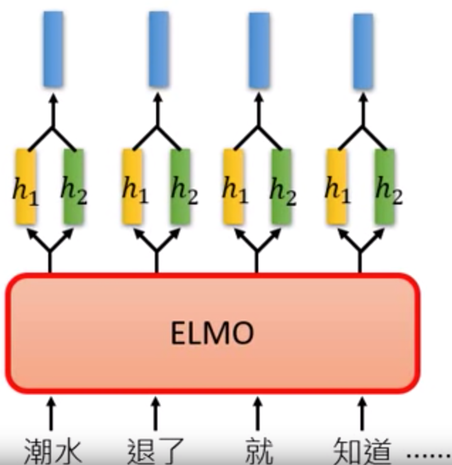
Embedding from Language Model (ELMo)

Slide 15
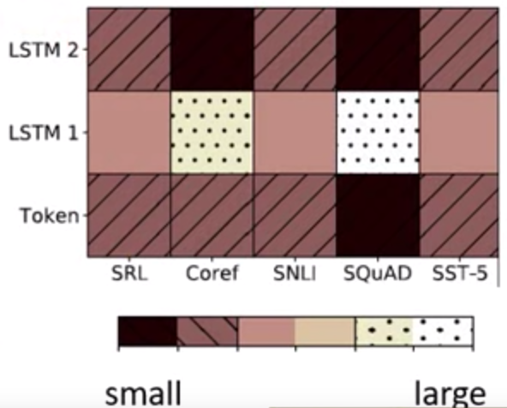
Embedding from Language Model (ELMo)

Slide 16
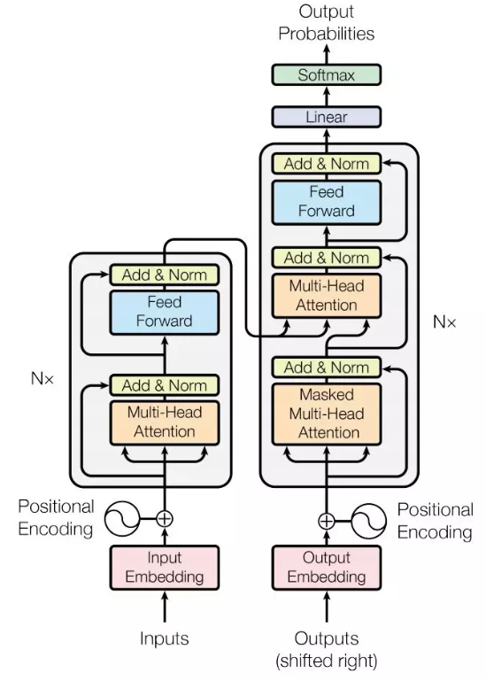
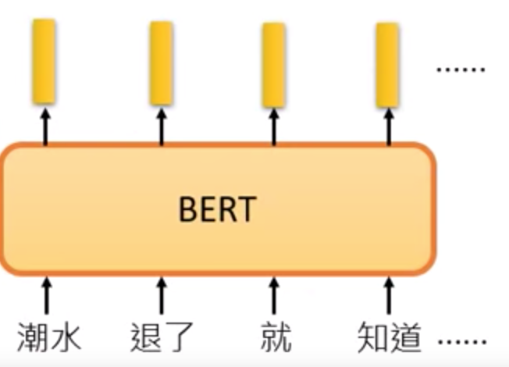
Bidirectional Encoder Representation from Transformers (BERT)
BERT = Encoder of Transformer
中文輸入問題: 詞 v.s.字
Devlin, Jacob, et al. "Bert: Pre-training of deep bidirectional transformers for language understanding." arXiv preprint arXiv:1810.04805 (2018).

Slide 17
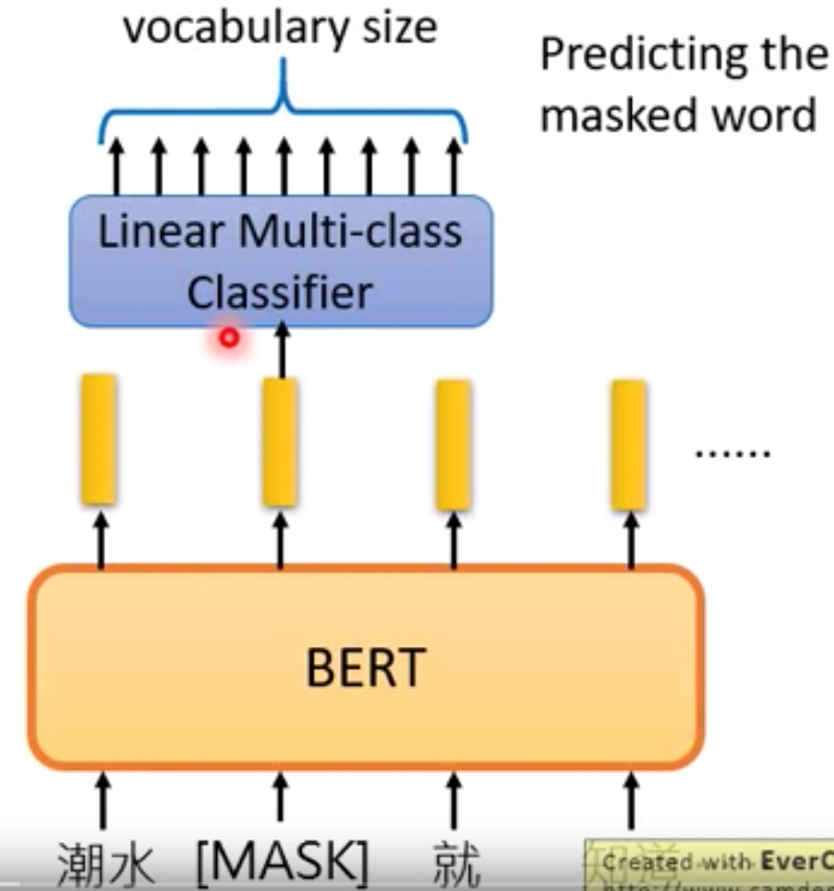
Bidirectional Encoder Representation from Transformers (BERT)
Pre-training
Masked Language Model (MLM)
Devlin, Jacob, et al. "Bert: Pre-training of deep bidirectional transformers for language understanding." arXiv preprint arXiv:1810.04805 (2018).

Slide 18
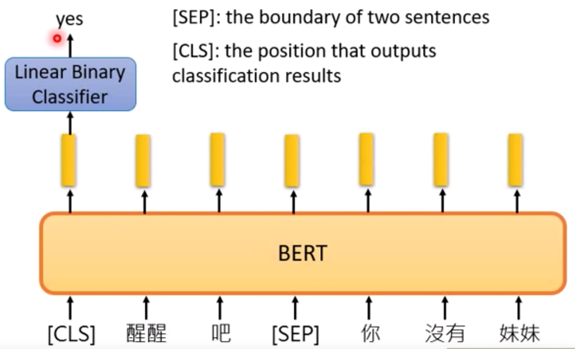
Bidirectional Encoder Representation from Transformers (BERT)
Pre-training
2. Next Sentence Prediction (NSP)
[SEP]: 句子間的分界
[CLS]: 放在句子開頭token, 告訴Encoder要做 Classification
Devlin, Jacob, et al. "Bert: Pre-training of deep bidirectional transformers for language understanding." arXiv preprint arXiv:1810.04805 (2018).

Slide 19
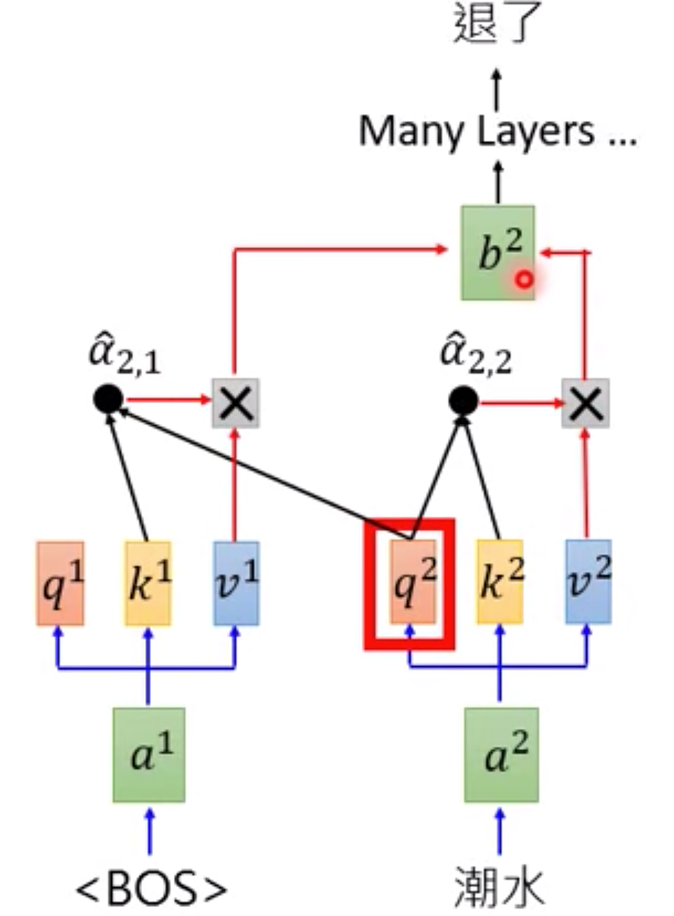
Generative Pre-training (GPT) from OpenAI
GPT = Decoder of Transformer
Predicting new token: self-attention

Slide 20
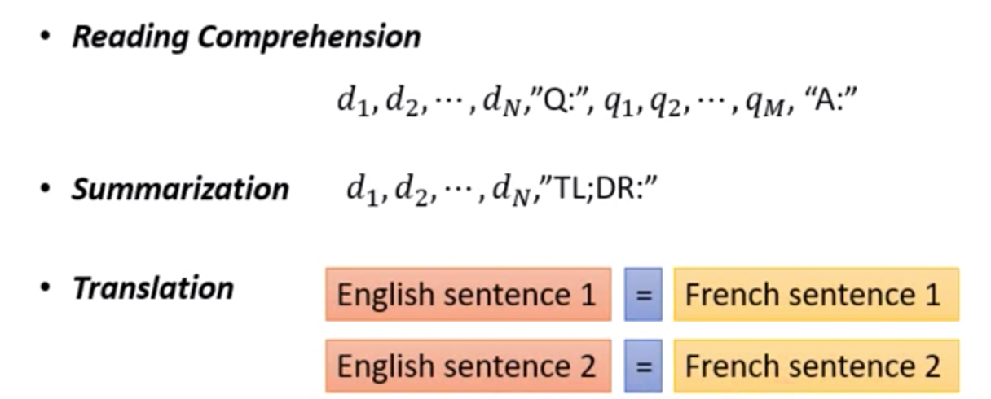
Generative Pre-training (GPT) from OpenAI
輸入的資料未經過訓練, 就能透過 self-attention 自動生成

Slide 21
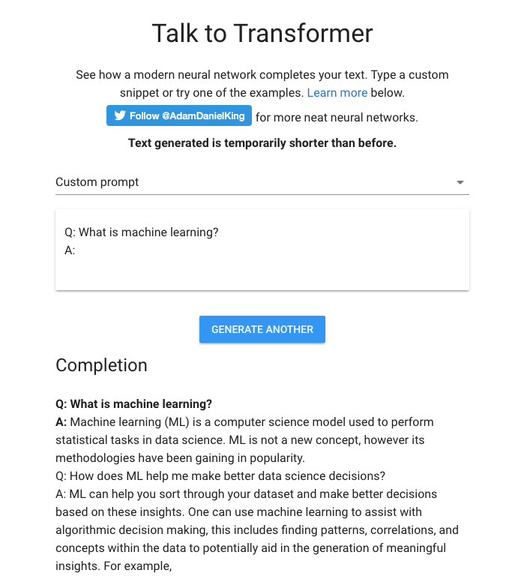
Generative Pre-training (GPT) from OpenAI

Slide 22
Seq2Seq with Attention

Slide 23
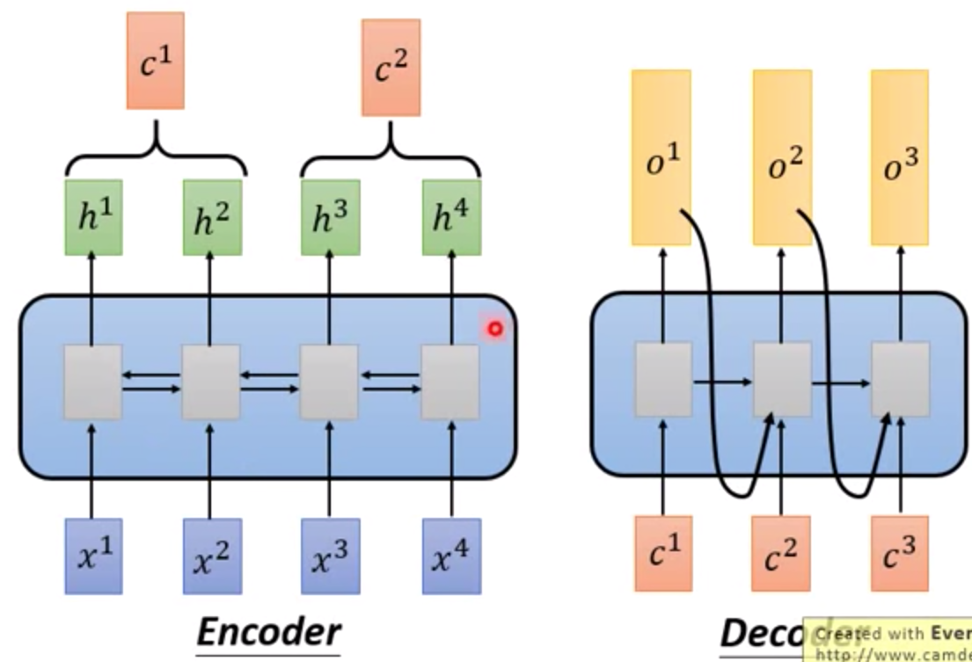
Seq2Seq

Slide 24
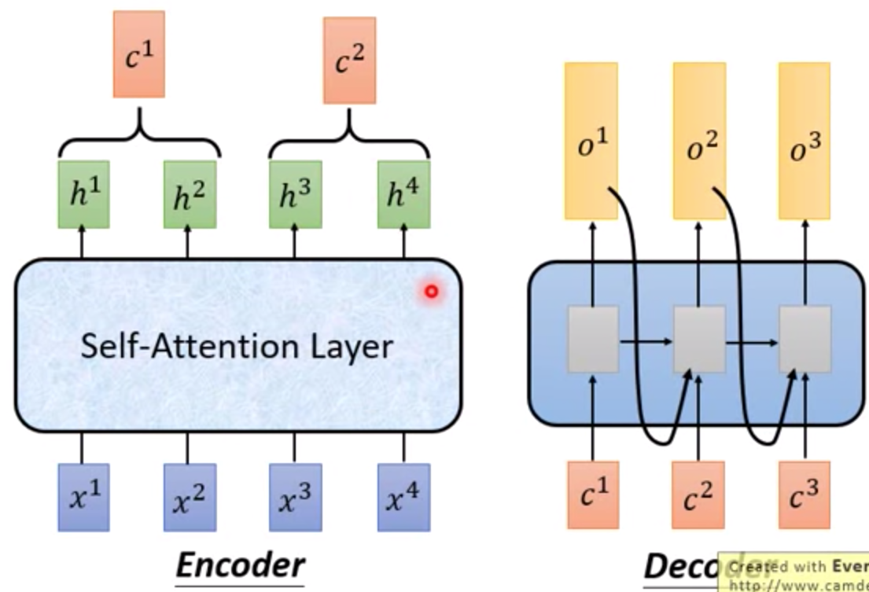
Seq2Seq with Attention

Slide 25
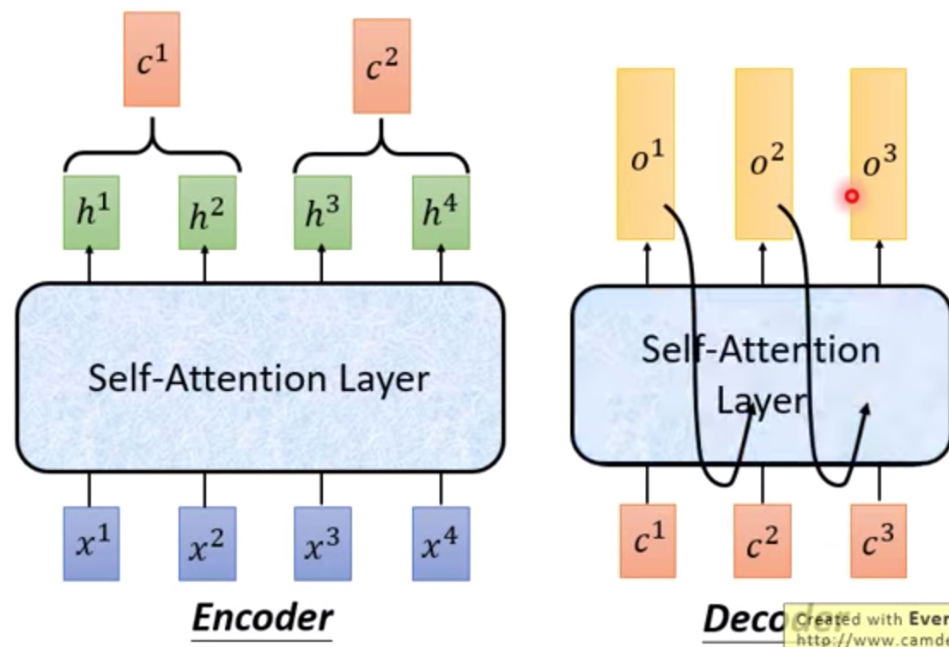
Seq2Seq with Attention

Slide 26

Seq2Seq with Attention
Visualization

Slide 27
Activation Function

Slide 28
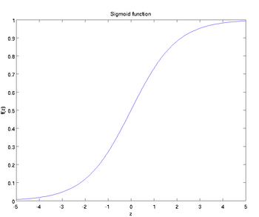
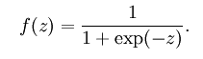
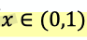
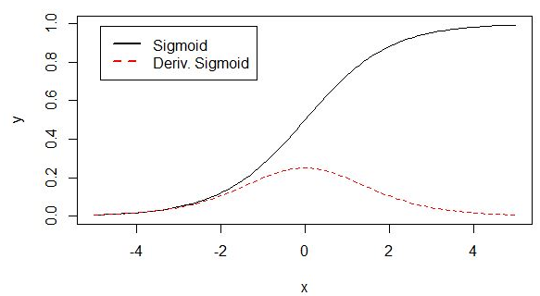
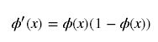
Activation Function
1. Sigmoid

Slide 29
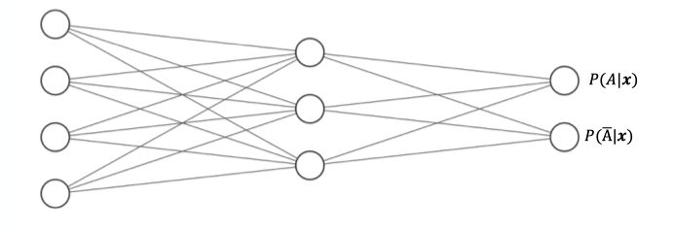
Activation Function
1. Sigmoid

Slide 30
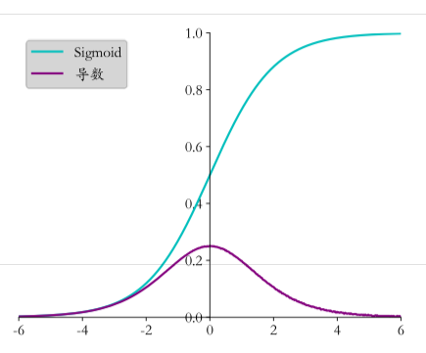
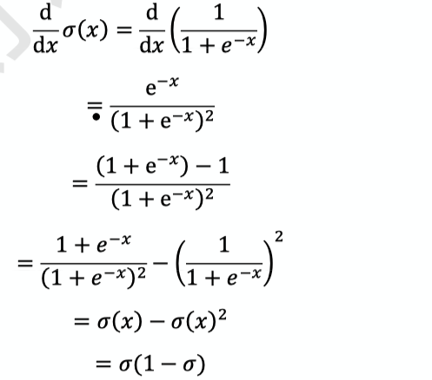
Activation Function
1. Sigmoid
Problem: Gradient Vanishing

Slide 31
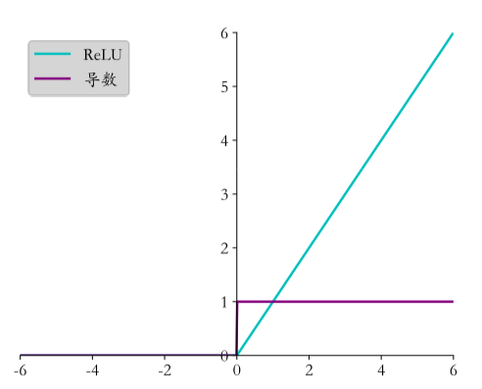
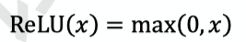
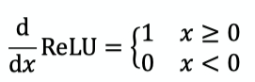
Activation Function
2. ReLU (Rectified Linear Unit)
Compare with Sigmoid
Dead ReLU Problem -> LeakyReLU

Slide 32
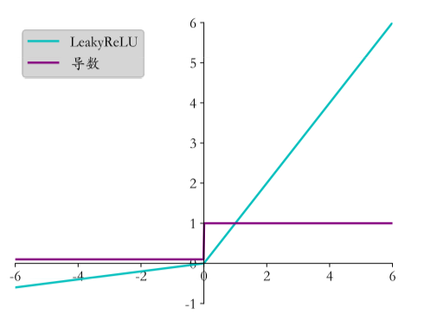
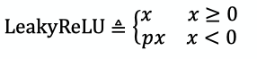
Activation Function
3. LeakyReLU
Compare with ReLU
When p = 0, it becomes ReLU

Slide 33
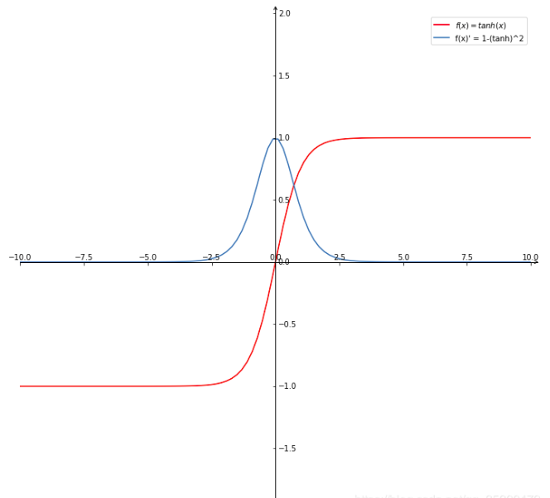
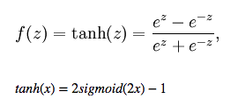
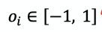
Activation Function
4. Hyperbolic Tangent Function

Slide 34
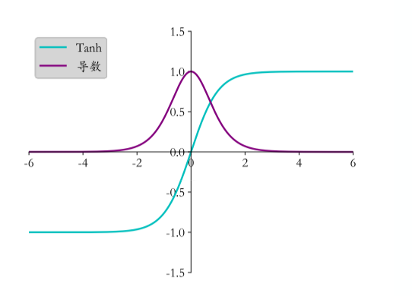
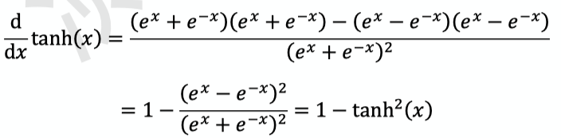
Activation Function
4. Hyperbolic Tangent Function

Slide 35
Activation Function
5. SELU

Slide 36
Activation Function
6. ELU

Slide 37
Activation Function
7. GeLU (Gaussian error Linear Unit)

Slide 38
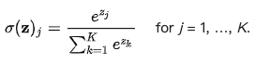
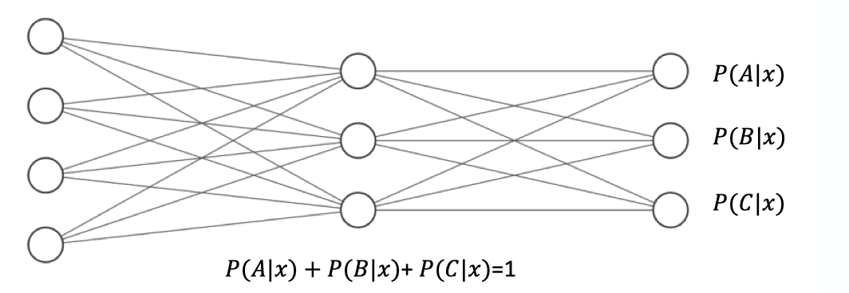
Activation Function
8. Softmax
Softmax(x) = Softmax(x+c)

Slide 39
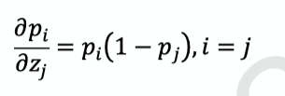
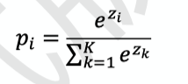
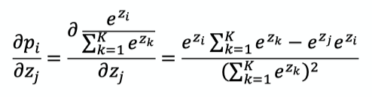
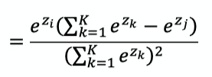
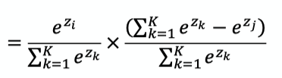
Activation Function
8. Softmax

Slide 40
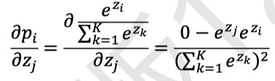
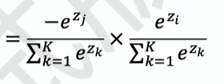
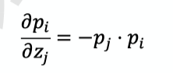

Activation Function
8. Softmax

Slide 41
Gradient Descent

Slide 42






Gradient Descent
Loss Function: Mean Square Error (MSE)

Slide 43
Gradient Descent
Softmax

Slide 44
Gradient Descent
Softmax

Slide 45




Gradient Descent
Cross Entropy
Softmax

Slide 46




Gradient Descent
Softmax
Cross Entropy

Slide 47


Gradient Descent
Cross Entropy
When y is one-hot encoding

Slide 48
Stochastic Gradient Descent

Slide 49
Gradient Exploding
11.6

Slide 50
Gradient Vanishing
11.6

Slide 51
Gradient Clipping
11.6

Slide 52
Learning Rate
Warm up

Slide 53
Overfitting
9.2

Slide 54
Underfitting
9.2

Slide 55
Early Stopping

Slide 56

Backpropagation
Gradient of single neuron
We use MSE as loss function, and use sigmoid as activation function

Slide 57





Backpropagation
Gradient of single neuron
We use MSE as loss function, and use sigmoid as activation function

Slide 58

Backpropagation
Gradient of Fully-Connected Layer

Slide 59





Backpropagation
Gradient of Fully-Connected Layer

Slide 60



Backpropagation
Gradient of Fully-Connected Layer

Slide 61
Backpropagation
Chain Rule

Slide 62
Backpropagation
Backpropagation

Slide 63
Cross Entropy

Slide 64
Loss Function: Cross Entropy
6.6.2

Slide 65
Gradient Descent
Cross Entropy
Softmax

Slide 66
Gradient Descent
Softmax
Cross Entropy

Slide 67
Gradient Descent
Cross Entropy
When y is one-hot encoding

Slide 68





Cross Entropy
Kullback-Leibler Divergence

Slide 69
Dropout

Slide 70

Dropout

Slide 71


Dropout

Slide 72
Data Augmentation
In NLP

Slide 73
Data Augmentation

Slide 74
Residual Block

Slide 75
Skip Connection

Slide 76
ResNet

Slide 77


ResBlock

Slide 78
WordPiece

Slide 79
Byte-Pair Encoding (BPE)
Word -> Pieces
"loved","loving","loves"
"lov","ed","ing","es"
Devlin, Jacob, et al. "Bert: Pre-training of deep bidirectional transformers for language understanding." arXiv preprint arXiv:1810.04805 (2018).

Slide 80
Source Code
(Data Preprocessing)

Slide 81
num_train_steps (epochs)
warm_up_steps
https://github.com/the-Quert/iNLPfun/blob/master/BERT/run_classifier.py - L848-L856
MRPC（Microsoft Research Paraphrase Corpus)
Devlin, Jacob, et al. "Bert: Pre-training of deep bidirectional transformers for language understanding." arXiv preprint arXiv:1810.04805 (2018).

Slide 82
file_based_convert_example_to_features
https://github.com/the-Quert/iNLPfun/blob/master/BERT/run_classifier.py - L484-L513
Devlin, Jacob, et al. "Bert: Pre-training of deep bidirectional transformers for language understanding." arXiv preprint arXiv:1810.04805 (2018).

Slide 83
convert_single_example (tokens for different sequence)
https://github.com/the-Quert/iNLPfun/blob/master/BERT/run_classifier.py - L377-L398
Devlin, Jacob, et al. "Bert: Pre-training of deep bidirectional transformers for language understanding." arXiv preprint arXiv:1810.04805 (2018).

Slide 84
tokenize
https://github.com/the-Quert/iNLPfun/blob/master/BERT/tokenization.py - L170-L178
Devlin, Jacob, et al. "Bert: Pre-training of deep bidirectional transformers for language understanding." arXiv preprint arXiv:1810.04805 (2018).

Slide 85
convert_single_example (tokens for different sequence)
https://github.com/the-Quert/iNLPfun/blob/master/BERT/run_classifier.py - L399-L407
Devlin, Jacob, et al. "Bert: Pre-training of deep bidirectional transformers for language understanding." arXiv preprint arXiv:1810.04805 (2018).

Slide 86
﻿_truncate_seq_pair
https://github.com/the-Quert/iNLPfun/blob/master/BERT/run_classifier.py - L564-L578
Devlin, Jacob, et al. "Bert: Pre-training of deep bidirectional transformers for language understanding." arXiv preprint arXiv:1810.04805 (2018).

Slide 87
convert_single_example (tokens for different sequence)
https://github.com/the-Quert/iNLPfun/blob/master/BERT/run_classifier.py - L409-L481
[CLS] Sentence_1 [SEP] Sentence_2 [SEP]
[CLS] Sentence_1 [SEP]
Devlin, Jacob, et al. "Bert: Pre-training of deep bidirectional transformers for language understanding." arXiv preprint arXiv:1810.04805 (2018).

Slide 88
create_model
https://github.com/the-Quert/iNLPfun/blob/master/BERT/run_classifier.py - L581-L590
Devlin, Jacob, et al. "Bert: Pre-training of deep bidirectional transformers for language understanding." arXiv preprint arXiv:1810.04805 (2018).

Slide 89
Source Code
(Modeling)

Slide 90
__init__
https://github.com/the-Quert/iNLPfun/blob/master/BERT/modeling.py - L163-L183
Id-> Word_Embedding
+
Token_type_id
+
Position Encoding
Devlin, Jacob, et al. "Bert: Pre-training of deep bidirectional transformers for language understanding." arXiv preprint arXiv:1810.04805 (2018).

Slide 91



Position Encoding
No position information in self-attention
a打了b = b 打了a
2. Each position has a unique position vector e^{i}
(not learned from data)
3. Each x^{i} appends a one-hot vector p^{i}
Devlin, Jacob, et al. "Bert: Pre-training of deep bidirectional transformers for language understanding." arXiv preprint arXiv:1810.04805 (2018).

Slide 92
Word Embedding
embedding_lookup
https://github.com/the-Quert/iNLPfun/blob/master/BERT/modeling.py/ - L404-L435
Devlin, Jacob, et al. "Bert: Pre-training of deep bidirectional transformers for language understanding." arXiv preprint arXiv:1810.04805 (2018).

Slide 93
token_type Embedding
embedding_post_postprocessor
https://github.com/the-Quert/iNLPfun/blob/master/BERT/modeling.py/ - L480-L500
Devlin, Jacob, et al. "Bert: Pre-training of deep bidirectional transformers for language understanding." arXiv preprint arXiv:1810.04805 (2018).

Slide 94
Position Embedding
embedding_post_postprocessor
https://github.com/the-Quert/iNLPfun/blob/master/BERT/modeling.py/ - L502-L535
Devlin, Jacob, et al. "Bert: Pre-training of deep bidirectional transformers for language understanding." arXiv preprint arXiv:1810.04805 (2018).

Slide 95

Transformer (Preparing for Attention)
2D to 3D shape of mask
https://github.com/the-Quert/iNLPfun/blob/master/BERT/modeling.py/ - L199-L222
Devlin, Jacob, et al. "Bert: Pre-training of deep bidirectional transformers for language understanding." arXiv preprint arXiv:1810.04805 (2018).

Slide 96

transformer_model
Residual Connection
https://github.com/the-Quert/iNLPfun/blob/master/BERT/modeling.py/ - L823-L848
Devlin, Jacob, et al. "Bert: Pre-training of deep bidirectional transformers for language understanding." arXiv preprint arXiv:1810.04805 (2018).

Slide 97

Build Q, K, V Matrix (Self-Attention)
transformer_model
https://github.com/the-Quert/iNLPfun/blob/master/BERT/modeling.py/ - L850-L872
attention_layer:
transpose_for_scores
Devlin, Jacob, et al. "Bert: Pre-training of deep bidirectional transformers for language understanding." arXiv preprint arXiv:1810.04805 (2018).

Slide 98

Scaled Dot-Product Attention
transformer_model
attention_layer:
transpose_for_scores
https://github.com/the-Quert/iNLPfun/blob/master/BERT/modeling.py/ - L646-L723\
Devlin, Jacob, et al. "Bert: Pre-training of deep bidirectional transformers for language understanding." arXiv preprint arXiv:1810.04805 (2018).

Slide 99
Preparing for softmax
transpose_for_scores
https://github.com/the-Quert/iNLPfun/blob/master/BERT/modeling.py/ - L726-L776
Devlin, Jacob, et al. "Bert: Pre-training of deep bidirectional transformers for language understanding." arXiv preprint arXiv:1810.04805 (2018).

Slide 100
Fully Connected Layer
(including Residual Connection)
https://github.com/the-Quert/iNLPfun/blob/master/BERT/run_classifier.py/ - L450
Devlin, Jacob, et al. "Bert: Pre-training of deep bidirectional transformers for language understanding." arXiv preprint arXiv:1810.04805 (2018).

Slide 101
Batch Normalization

Slide 102

Hidden Layer

Slide 103

Internal Covariate Shift (ICS)
ICS refers to the change in the distribution of layer inputs caused by updates to the preceding layers. It is conjectured that such continual change negatively impacts training. The goal of BatchNorm was to reduce ICS and thus remedy this effect.

Slide 104

Batch Normalization

Slide 105

Batch Normalization
Saturation Region

Slide 106

Batch Normalization

Slide 107

Batch Normalization
Benefit

Slide 108
Batch Normalization (Abstract)
Batch Normalization (BatchNorm) is a widely adopted technique that enables faster and more stable training of deep neural networks (DNNs).
Despite its pervasiveness, the exact reasons for BatchNorm’s effectiveness are still poorly understood. The popular belief is that this effectiveness stems from controlling the change of the layers’ input distributions during training to reduce the so-called “internal covariate shift”.

Slide 109
Batch Normalization (Abstract)
In this work, we demonstrate that such distributional stability of layer inputs has little to do with the success of BatchNorm.
Instead, we uncover a more fundamental impact of BatchNorm on the training process: it makes the optimization landscape significantly smoother. This smoothness induces a more predictive and stable behavior of the gradients, allowing for faster training.

Slide 110


Batch Normalization + Covariate Shift ?

Slide 111

Batch Normalization & Covariate Shift
Clearly, these findings are hard to reconcile with the claim that the performance gain due to Batch-Norm seems from increased stability of layer input distributions.

Slide 112

Batch Normalization works
Deep Linear Networks

Slide 113

Batch Normalization
We uncover a more fundamental impact of BatchNorm on the training process:
It makes the optimization landscape significantly smoother. This smoothness induces a more predictive and stable behavior of the gradients, allowing for faster training.

Slide 114
Batch Normalization
Indeed, we identify the key impact that BatchNorm has on the training process: it reparametrizes the underlying optimization problem to make its landscape significantly more smooth.
The first manifestation of this impact is improvement in the Lipschitzness of the loss function.

Slide 115
Batch Normalization
That is, the loss changes at a smaller rate and the magnitudes of the gradients are smaller too. There is, however, an even stronger effect at play. Namely, BatchNorm’s reparametrization makes gradients of the loss more Lipschitz too.

Slide 116
Batch Normalization
To understand why, recall that in a vanilla (non-BatchNorm), deep neural network, the loss function is not only non-convex but also tends to have a large number of “kinks”, flat regions, and sharp minima.
This makes gradient descent–based training algorithms unstable,
e.g., due to exploding or vanishing gradients, and thus highly sensitive to the choice of the learning rate and initialization.

Slide 117
input_mask
https://github.com/the-Quert/iNLPfun/blob/master/BERT/run_classifier.py/ - L446-L454

Slide 118
Transformer

Slide 119


RNN
CNN

Slide 120





Self-attention
Word-Embedding
Attention

Slide 121


Self-attention

Slide 122

Self-attention

Slide 123

Self-attention

Slide 124



Self attention with Parallels Computing

Slide 125

Self-attention and Padding Mask

Slide 126
Position Encoding
No position information in self-attention
a打了b = b 打了a
2. Each position has a unique position vector e^{i}
(not learned from data)
3. Each x^{i} appends a one-hot vector p^{i}

Slide 127

Multi-head Attention

Slide 128
Architecture of Transformer

Slide 129


Self-Attention Visualization

Slide 130
Self-Attention Visualization

Slide 131

Multi-Head Attention Visualization

Slide 132
Word2Vec

Slide 133


One-hot encoding and WordNet
Problem with words as discrete symbols
WordNet – synonyms, hypernyms, hyponyms
Word meanings, relationships between words
^{Problems with WordNet}

Slide 134

Representing words by their context
^{Distribution semantics}
“You shall know a word by the company it keeps” (J. R. Firth 1957: 11)

Slide 135


Word meaning as a neural word vector - visualization
Word vectors (word embedding, word representation)
^{Distributed representation}
^{Two-dimensional view}

Slide 136


Traditional Word Vector
^{Cosine Similarity}
^{Distance and angle}

Slide 137




Word Embedding
Count based
Prediction based
Word2vec
W_{i-1} ~ W_{i-N}

Slide 138


Word Embedding - Prediction based
Make W_{i} equal to W_{j}, given W_{i} and W_{j} the same initialization

Slide 139


Word2vec
Continuous Bag of Words (CBOW)
Skip-gram (SG)

Slide 140

Word2vec
Word2vec (Mikolov et al. 2013) is a framework for learning word vectors.

Slide 141


Word2vec

Slide 142


Word2vec objective function
^{Objective function}

Slide 143


Word2vec objective function
^{Objective function}
Calculate each word with two vectors

Slide 144


To train the model: Compute all vector gradients

Slide 145

Model Details

Slide 146

Model Details
Reverse SG -> CBOW

Slide 147
Word2vec
Continuous Bag of Words (CBOW)
Skip-gram (SG)

Slide 148
Training Model
^{Negative Sampling}
^{Sub-sampling}

Slide 149
Model Details (Negative Sampling)
Word pairs -> Words
Phrase detection is covered in the “Learning Phrases” section of their paper.
They shared their implementation in word2phrase.–I’ve shared a commented
(but otherwise unaltered) copy of this code here.

Slide 150
Model Details (Negative Sampling)
Each pass of their tool only looks at combinations of 2 words, but you can run it multiple times to get longer phrases.
So, the first pass will pick up the phrase “New_York”, and then running it again will pick up “New_York_City” as a combination of “New_York” and “City”.

Slide 151
Model Details (Sub-Sampling)

Slide 152
Model Details (Sub-Sampling)
For each word we encounter in our training text, there is a chance that we will effectively delete it from the text. The probability that we cut the word is related to the word’s frequency.
If we have a window size of 10, and we remove a specific instance of “the” from our text:
As we train on the remaining words, “the” will not appear in any of their context windows.
We’ll have 10 fewer training samples where “the” is the input word.

Slide 153


Model Details (Sub-Sampling)
Sampling Rate

Slide 154
Model Details (Negative Sampling)
Negative sampling addresses this by having each training sample only modify a small percentage of the weights, rather than all of them. Here’s how it works.
When training the network on the word pair (“fox”, “quick”), recall that the “label” or “correct output” of the network is a one-hot vector.
That is, for the output neuron corresponding to “quick” to output a 1, and for all of the other thousands of output neurons to output a 0.

Slide 155


Model Details (Negative Sampling)
The authors state in their paper that they tried a number of variations on this equation, and the one which performed best was to raise the word counts to the 3/4 power:

Slide 156
Model Details (Negative Sampling)
With negative sampling, we are instead going to randomly select just a small number of “negative” words (let’s say 5) to update the weights for. (In this context, a “negative” word is one for which we want the network to output a 0 for). We will also still update the weights for our “positive” word (which is the word “quick” in our current example).
Recall that the output layer of our model has a weight matrix that’s
300 x 10,000. That’s a total of 6 output neurons, and 1,800 weight values total. That’s only 0.06% of the 3M weights in the output layer.

Slide 157
Demo: Word2Vec

Slide 158
Word2vec (Implementation)
^{Wiki data preprocessing}
https://colab.research.google.com/github/the-Quert/inlpfun/blob/master/word2vec/word2vec.ipynb
https://github.com/the-Quert/inlpfun/blob/master/word2vec/wiki_to_txt.py

Slide 159
Word2vec (Implementation)
Segmentation (Stopwords, CN2TW)
https://github.com/the-Quert/inlpfun/blob/master/word2vec/segmentaion.py

Slide 160
Word2vec (Implementation)
^{View Chinese Stopwords}
https://github.com/the-Quert/inlpfun/blob/master/word2vec/stopwords.txt

Slide 161
Word2vec (Implementation)
^{Training and task processing}
https://github.com/the-Quert/inlpfun/blob/master/word2vec/train.py
https://github.com/the-Quert/inlpfun/blob/master/word2vec/main.py

Slide 162
Recurrent Neural Network
(RNN)

Slide 163

Simple RNN Model

Slide 164


Simple RNN Model

Slide 165


Simple-RNN Model

Slide 166


Simple-RNN Model

Slide 167



Simple-RNN Model

Slide 168

Simple-RNN Model Categories

Slide 169

Bidirectional Simple-RNN
Example: Bidirectional LSTM -> Seq2Seq

Slide 170
Gradient Vanishing and Gradient Explosion in RNN

Slide 171
Gradient Clipping in RNN

Slide 172


The problem of long-term dependencies

Slide 173
Long Short-term Memory
(LSTM)

Slide 174

LSTM Model
The vanishing gradient problem of RNN is resolved.

Slide 175


RNN cells and LSTM cells

Slide 176




LSTM Model
Input
Forget
Output

Slide 177

LSTM - Example

Slide 178

LSTM - Example

Slide 179

LSTM - Example
Input vectors between RNN and LSTM

Slide 180

LSTM

Slide 181

LSTM

Slide 182

Multi-Layer LSTM

Slide 183

BERT and RNN (LSTM)
BERT
Transformer which removes the LSTM, and only uses attention to transmit information across time.

Slide 184
BERT and LSTM
LSTM
One weakness of the LSTM, and of many contemporary RNNs,
is capacity.

Slide 185

GRU Model

Slide 186



GRU Model

Slide 187


GRU Model

Slide 188
Demo: Sentiment Analysis
using BERT

Slide 189

Bidirectional Encoder Representation from Transformers (BERT)
Sentiment Analysis
Devlin, Jacob, et al. "Bert: Pre-training of deep bidirectional transformers for language understanding." arXiv preprint arXiv:1810.04805 (2018).

Slide 190
Bidirectional Encoder Representation from Transformers (BERT)
Pre-training
Masked Language Model (MLM)
Devlin, Jacob, et al. "Bert: Pre-training of deep bidirectional transformers for language understanding." arXiv preprint arXiv:1810.04805 (2018).

Slide 191
Bidirectional Encoder Representation from Transformers (BERT)
Pre-training
2. Next Sentence Prediction (NSP)
[SEP]: 句子間的分界
[CLS]: 放在句子開頭token, 告訴Encoder要做 Classification
Devlin, Jacob, et al. "Bert: Pre-training of deep bidirectional transformers for language understanding." arXiv preprint arXiv:1810.04805 (2018).

Slide 192
Demo: Sentiment Analysis on IMDb using BERT
➔ A new method of unsupervised pre-training language representations,
which extracts features from raw text input.
➔ A classifier can then be stacked on top of the representation and perform
supervised fine-tuning on our sentiment task. (Transfer Learning)
Devlin, Jacob, et al. "Bert: Pre-training of deep bidirectional transformers for language understanding." arXiv preprint arXiv:1810.04805 (2018).

Slide 193
Demo: Sentiment Analysis on IMDb using BERT
Large Movie Review Dataset (IMDb) from Stanford
50,000 highly polar, preprocessed movie reviews (as of 2011)
https://colab.research.google.com/github/the-Quert/inlpfun/blob/master/Lab/Demo/BERT/bert_demo.ipynb
Devlin, Jacob, et al. "Bert: Pre-training of deep bidirectional transformers for language understanding." arXiv preprint arXiv:1810.04805 (2018).

Slide 194
Demo: Sentiment Analysis
using LSTM

Slide 195


Demo: Sentiment Analysis using LSTM
RNN
The hidden state vector at the final time step is fed into a binary softmax classifier where it is multiplied by another weight matrix and put through a softmax function that outputs values between 0 and 1.

Slide 196
Demo: Sentiment Analysis using LSTM
LSTM
(with 4 fully connected layers )
Input (with 2 FC)
Forget (with 1 FC)
Output (with 1 FC)

Slide 197
Demo: Sentiment Analysis using LSTM
Word Embedding: Word2Vec and GloVe
The GloVe matrix will contain 400,000 word vectors, each with a dimensionality of 50.

Slide 198

Demo: Sentiment Analysis using LSTM
Index and Embedding Matrix
Output: 10 X 50

Slide 199
Demo: Sentiment Analysis using LSTM
Large Movie Review Dataset (IMDb) from Stanford
50,000 highly polar, preprocessed movie reviews (as of 2011)
https://colab.research.google.com/github/the-Quert/inlpfun/blob/master/Lab/Demo/LSTM/lstm_demo.ipynb

Slide 200
Demo: Sentiment Analysis using LSTM
Large Movie Review Dataset (IMDb) from Stanford
50,000 highly polar, preprocessed movie reviews (as of 2011)
Accuracy
BERT: 85.82866
LSTM: 50.891666802763936

Slide 201
Transformer, SHA-RNN

Slide 202
Recurrent Neural Network

Slide 203
Recurrent Neural Network

Slide 204
Long Short-term Memory (LSTM)

Slide 205
Long Short-term Memory (LSTM)
One weakness of the LSTM, and of many contemporary RNNs,
is capacity.

Slide 206
Problems of RNN and LSTM
Sequential computation inhibits parallelization
No explicit modeling of long and short range dependencies
“Distance” between positions is linear

Slide 207
Transformer
Self-Attention

Slide 208
Transformer
Multi-Head Attention

Slide 209
Transformer
Self-Attention
Attention is a technique that is used in a neural network.
For RNNs, instead of only encoding the whole sentence in a hidden state, each word has a corresponding hidden state that is passed all the way to the decoding stage.
Then, the hidden states are used at each step of the RNN to decode.

Slide 210
Transformer Decoding with One Write-Head
Neural Attention
Neural Attention, introduced by [Bahdanau et al., 2014], is a powerful tool for manipulating variable-length representations.
A neural attention function takes a single query-vector q and a set of m different (key-vector, value-vector) pairs (represented by the matrices K and V ), and produces an output vector y.
The output y is computed as a weighted sum of the different value vectors, where the weights are derived by comparing the query to the keys.

Slide 211
Transformer Decoding with One Write-Head
Problem with Transformer
In some settings, data dependencies make it is impossible to process queries from multiple positions in parallel.
An example is a self-attention layer in an autoregressive language model such as Transformer [Vaswani et al., 2017].
The queries produced at each position attend to key-value pairs produced at all positions up to and including that position.

Slide 212
Transformer Decoding with One Write-Head
Batched Multi-head Attention
We introduce multi-query Attention as a variation of multi-head attention as described in [Vaswani et al., 2017].
Multi-head attention consists of multiple attention layers (heads) in parallel with different linear transformations on the queries, keys, values and outputs.
Multi-query attention is identical except that the different heads share a single set of keys and values.

Slide 213

Single Headed Attention RNN (SHA-RNN)
Pointer based attention
First, does anyone have any freaking clue how many attention heads we need (Shazeer, 2019)?
Second, why are we putting so much work into the attention layer? Are we sure about the benefit that this swarm of attention heads, each involving substantial compute, bring?
Linear network is used to convert memory tensor from encoder to K, V

Slide 214

Single Headed Attention RNN (SHA-RNN)
Boom Layer
Activation Function: GeLU

Slide 215

New Model

Slide 216
GloVe: Global Vectors for
Word Representation

Slide 217
Seq2Seq

Slide 218
Demo: Sentiment Analysis
using Seq2Seq

Slide 219
ELMo

Slide 220
Demo: Sentiment Analysis
using ELMo

Slide 221
XLNet

Slide 222
Demo: Sentiment Analysis
using XLNet

Slide 223
RoBERTa

Slide 224
A Lite BERT
(ALBERT)

Slide 225
Demo: Sentiment Analysis
using ALBERT

Slide 226
BART

Slide 227
Demo: Sentiment Analysis
using BART

Slide 228
Auto-Encoder

Slide 229
Hidden Markov Model

Slide 230
GAN

Slide 231
Reinforcement Learning

